Slide 1
IST718 Use case: Sentiment Analysis
Willard Williamson
Adjunct Professor
iSchool, Syracuse University
linkedin.com/in/ncc-1701-d

Slide 2
Attendance
Please fill out the attendance sheet: https://docs.google.com/spreadsheets/d/1G5tiqXQn9mwyubWdINtPI_QONXH1_2U8oYikksgWlss/edit?usp=sharing
Write in a ‘1’ if you are present

Slide 3
Objectives
The Sentiment Analysis problem
A simple solution without data science
Application to IMDB reviews
Regularized logistic regression
Data-driven word sentiments
Predicting sentiments in Tweets
Spark ML demo

Slide 4


The Sentiment Analysis problem
Important information about products and services are only expressed through text

Slide 5


The Sentiment Analysis problem (2)
Tumasjan, Andranik; O.Sprenger, Timm; G.Sandner, Philipp; M.Welpe, Isabell (2010). "Predicting Elections with Twitter: What 140 Characters Reveal about Political Sentiment". "Proceedings of the Fourth International AAAI Conference on Weblogs and Social Media“
https://www.aaai.org/ocs/index.php/ICWSM/ICWSM10/paper/viewFile/1441/1852

Slide 6
The Sentiment Analysis problem
From Wikipedia: Sentiment analysis refers to the use of natural language processing, text analysis and computational linguistics to identify and extract subjective information in source materials.

Slide 7
A simple solution without much data science
Get a list of positive words (+1) and negative words (-1)
Compute the mean sentiment in the text based on words
If mean is greater than 0, then sentence is positive

Slide 8
Application to IMDB
IMDB (The Internet Movie Database) contains volunteers’ reviews of movies
We will be using a dataset of 12.5K positive reviews and 12.5K negative reviews
Reviews (from 1-10) with greater than 7 had positive sentiment and less than 4 had negative sentiment
Andrew L. Maas, Raymond E. Daly, Peter T. Pham, Dan Huang, Andrew Y. Ng, and Christopher Potts. (2011). Learning Word Vectors for Sentiment Analysis. The 49th Annual Meeting of the Association for Computational Linguistics (ACL 2011).

Slide 9


Application to IMDB
+1
+1

Slide 10
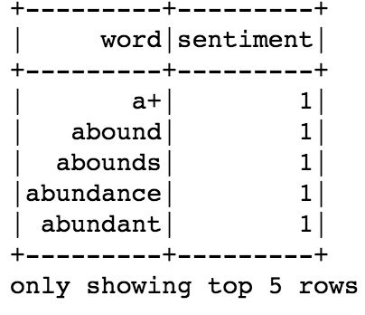
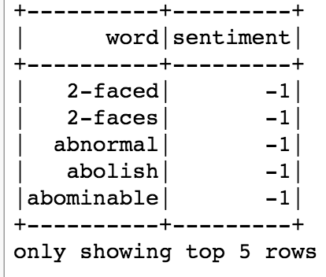
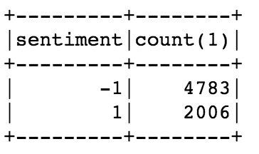
Tagging based on list of word sentiments
Positive words:
Negative words:

Slide 11
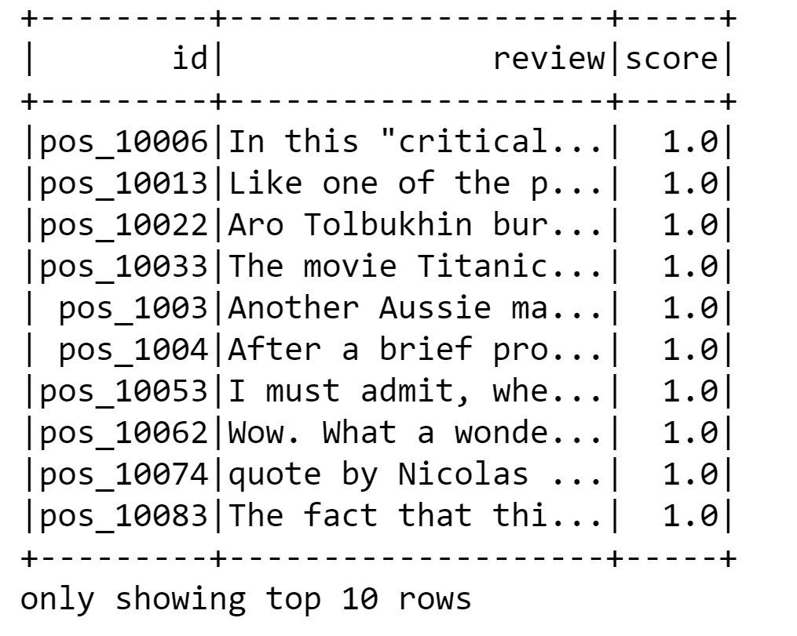
Sample Review Data

Slide 12
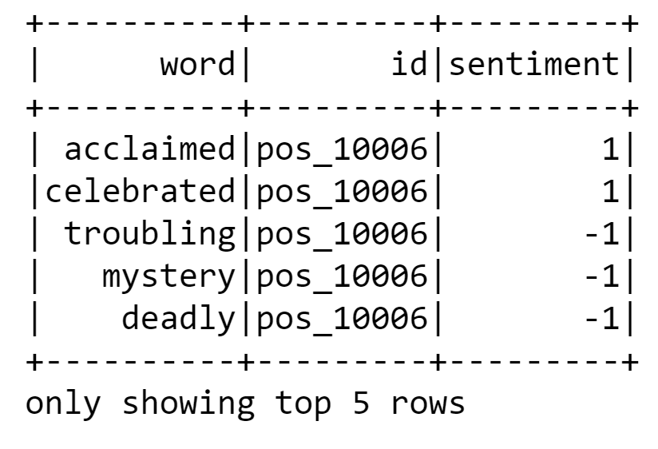
Explode the Reviews, Keep the Review ID, Add the Sentiments
Compute sentiment by averaging the sentiment column on a per id basis
For example, compute the average word sentiment for id = pos_10006
If the average is positive, predict the review sentiment is positive
If the average is negative, predict the review sentiment is negative

Slide 13
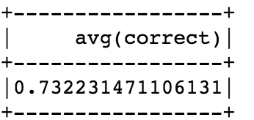
Simple model performance
Predicting sentiment based on simple word sentiment averaging:
Labels are 0 for negative review and 1 for positive
The dataset is artificially balanced: 12500 positive and 12500 negative
Measuring performance with accuracy is appropriate since dataset is balanced.
Pretty good considering that human-human correlation of sentiment rating is around 80%! (see “Evaluation” section here: https://en.wikipedia.org/wiki/Sentiment_analysis)

Slide 14
Problems with simple approach
Positive and negative words have the same weight (e.g., good == amazing)
In real life there are usually more positive than negative reviews, and therefore accuracy might not be the best metric for model evaluation in a more real life scenario
Can we use a ROC curve to score this model?

Slide 15
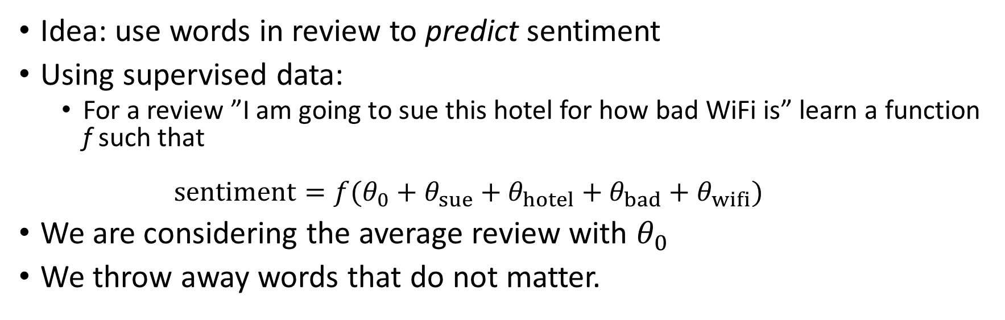
A data science approach
Idea: use words in review to predict sentiment
Using supervised data:
For a review ”I am going to sue this hotel for how bad WiFi is” learn a function f such that $sentiment=f(θ_{0}+θ_{sue}+θ_{hotel}+θ_{bad}+θ_{wifi})$
We are considering the average review with $θ_{0}$
We throw away words that do not matter.

Slide 16
From text to vectors
We need to represent reviews as vectors so that we can estimate their weights
We should consider how many times a word is mentioned “This hotel is super super super good” vs “This hotel is super good”

Slide 17
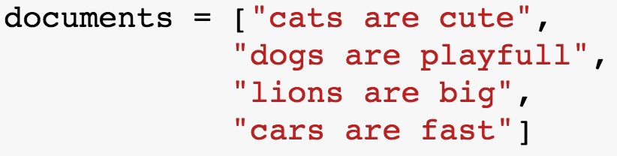
Consider the following documents
There are 4 documents in the corpus
The first document in the corpus has 3 words: cats, are, cute

Slide 18
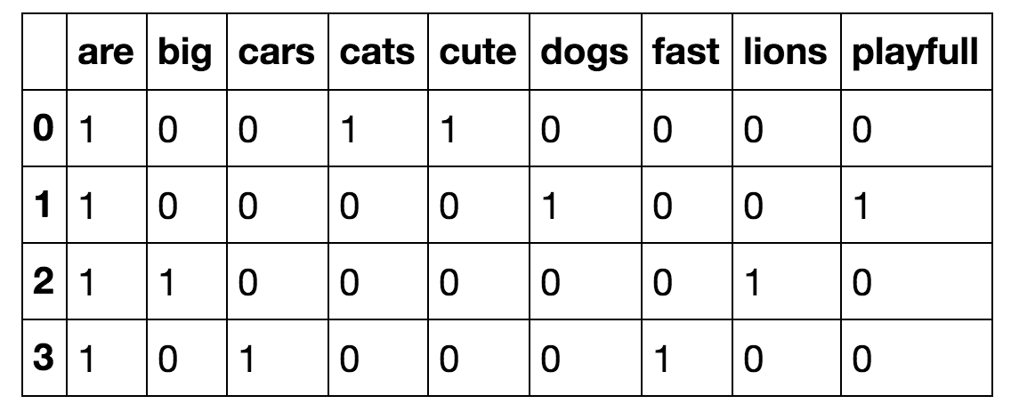
Word counting
It inflates common words: “are” would be counted as much as “cats” and “dogs”

Slide 19
Term Frequency - Inverse Document Frequency (TF-IDF)
TFIDF is a numeric statistic that is intended to reflect how important a word is to a document in a collection or corpus.
Often used as a weighting factor in searches of information retrieval, text mining, and user modeling.
https://en.wikipedia.org/wiki/Tf%E2%80%93idf

Slide 20
TFIDF
The TF value increases proportionally to the number of times a word appears in the document (the ‘tf’ part of the equation below)
The IDF value is discounted by the number of documents in the corpus that contain the word, which helps to adjust for the fact that some words appear more frequently in general (the ‘idf’ value in the equation below)
tfidf(t, d, D) = tf(t, d) * idf(t, D) where
t = a specific term (word)
d = a specific document
D = All documents in the collection of documents (corpus)

Slide 21
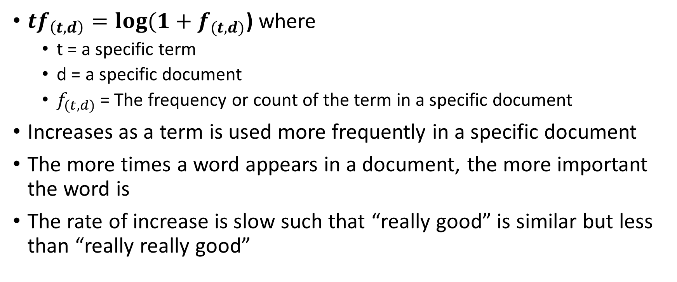
Term Frequency
${tf}_{\left(t, d\right)}=log⁡(1+f_{(t,d)}$) where
t = a specific term
d = a specific document
$f_{(t,d)}$ = The frequency or count of the term in a specific document
Increases as a term is used more frequently in a specific document
The more times a word appears in a document, the more important the word is
The rate of increase is slow such that “really good” is similar but less than “really really good”

Slide 22
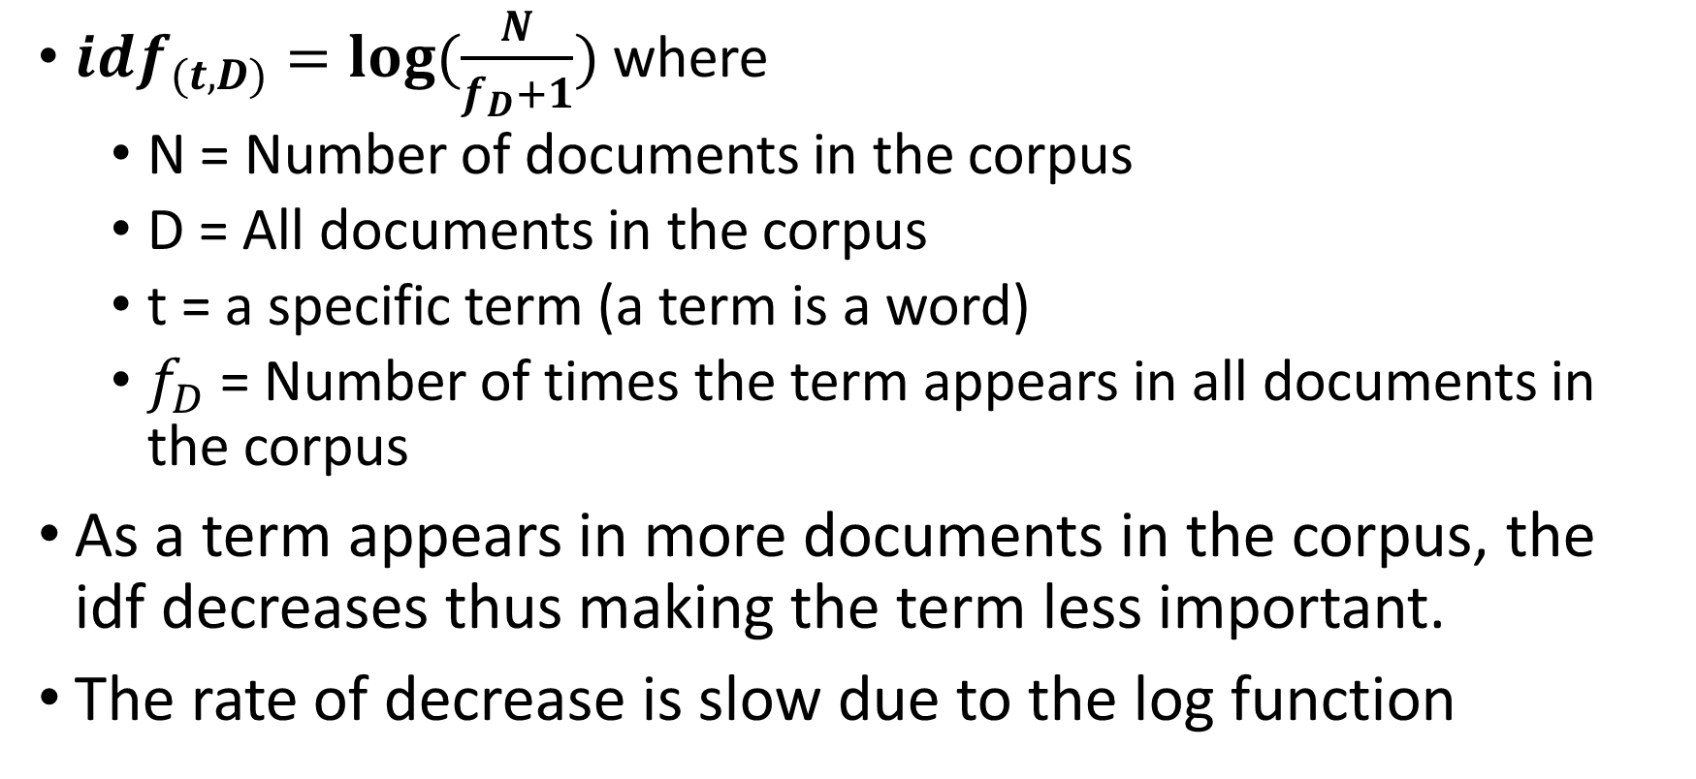
Inverse Document Frequency
${idf}_{(t,D)}=log⁡(\frac{N}{f_{D}+1})$ where
N = Number of documents in the corpus
D = All documents in the corpus
t = a specific term (a term is a word)
$f_{D}$ = Number of times the term appears in all documents in the corpus
As a term appears in more documents in the corpus, the idf decreases thus making the term less important.
The rate of decrease is slow due to the log function

Slide 23
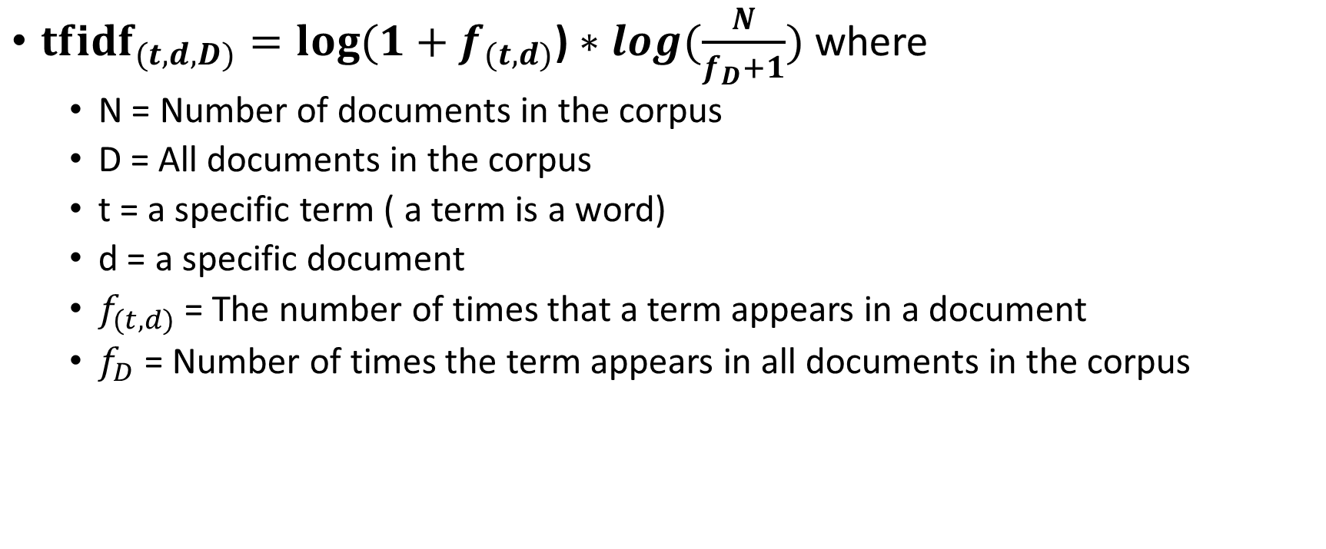
TF-IDF Equation
${tfidf}_{(t,d,D)}=log⁡(1+f_{(t,d)}\text{)}∗log⁡(\frac{N}{f_{D}+1})$ where
N = Number of documents in the corpus
D = All documents in the corpus
t = a specific term ( a term is a word)
d = a specific document
$f_{(t,d)}$ = The number of times that a term appears in a document
$f_{D}$ = Number of times the term appears in all documents in the corpus

Slide 24
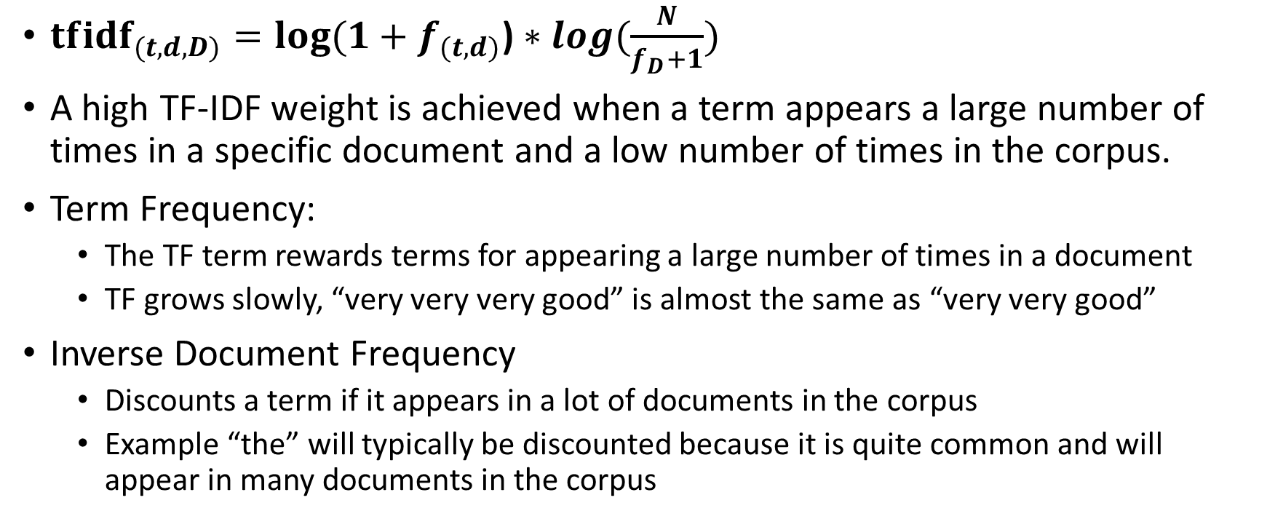
Putting it All Together: TF-IDF
${tfidf}_{(t,d,D)}=log⁡(1+f_{(t,d)}\text{)}∗log⁡(\frac{N}{f_{D}+1})$
A high TF-IDF weight is achieved when a term appears a large number of times in a specific document and a low number of times in the corpus.
Term Frequency:
The TF term rewards terms for appearing a large number of times in a document
TF grows slowly, “very very very good” is almost the same as “very very good”
Inverse Document Frequency
Discounts a term if it appears in a lot of documents in the corpus
Example “the” will typically be discounted because it is quite common and will appear in many documents in the corpus

Slide 25
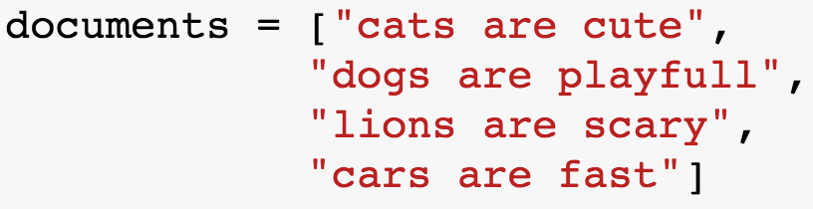
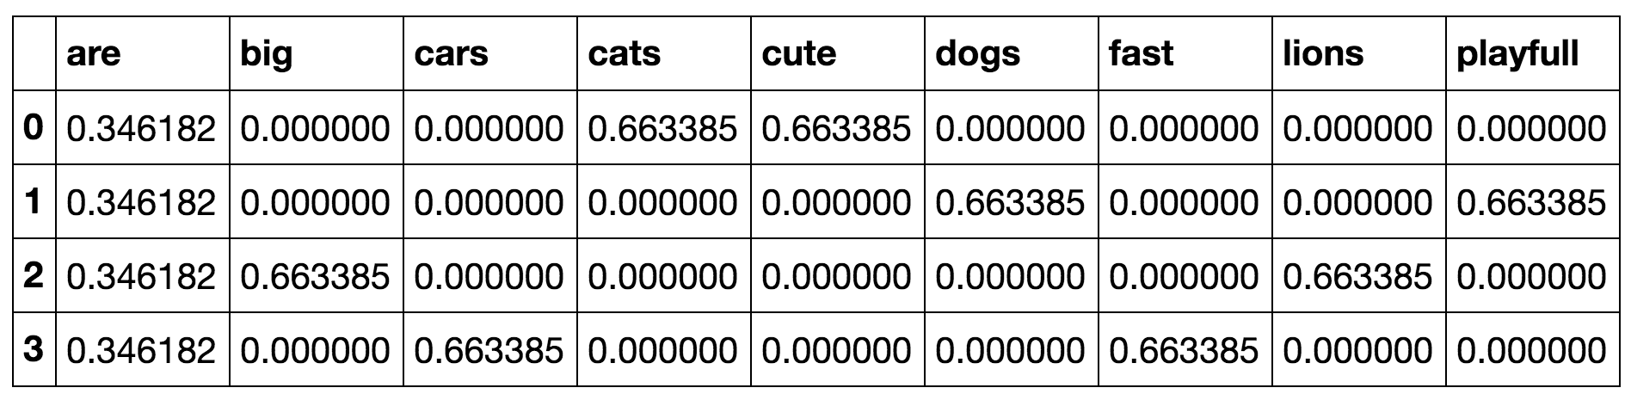
TF-IDF Example Data

Slide 26
Logistic Regression
Linear regression predicts a continuous outcome in the real numbers
The goal of logistic regression is to predict categories like true or false
For example, could be used to predict positive / negative sentiment

Slide 27
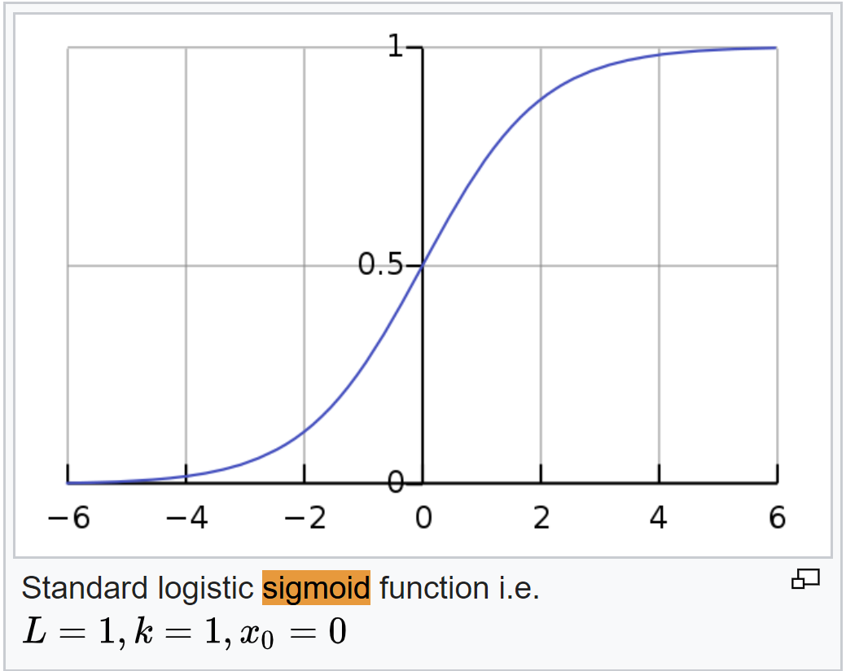
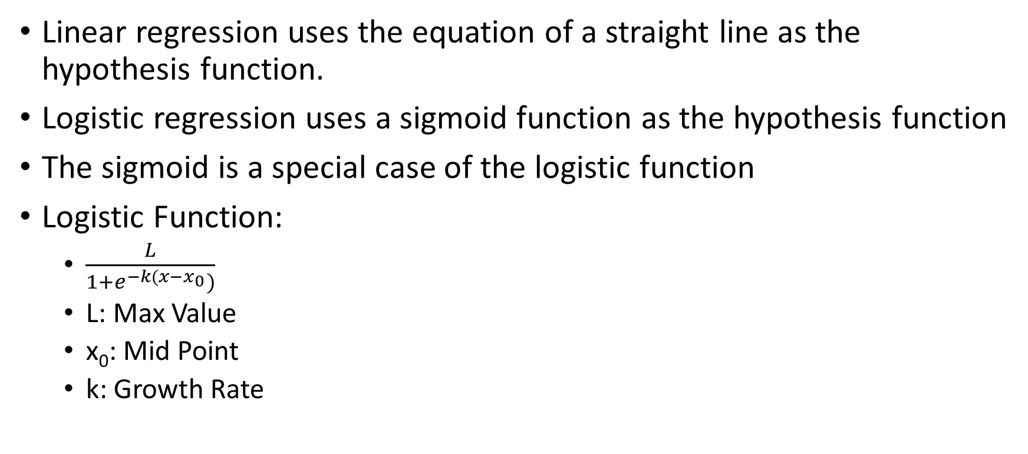
Why is it called logistic regression
Linear regression uses the equation of a straight line as the hypothesis function.
Logistic regression uses a sigmoid function as the hypothesis function
The sigmoid is a special case of the logistic function
Logistic Function:
$\frac{L}{1+e^{−k(x−x_{0}})}$
L: Max Value
x₀: Mid Point
k: Growth Rate
Sigmoid:
L = 1, k = 1, x₀=0
https://en.wikipedia.org/wiki/Logistic_function

Slide 28

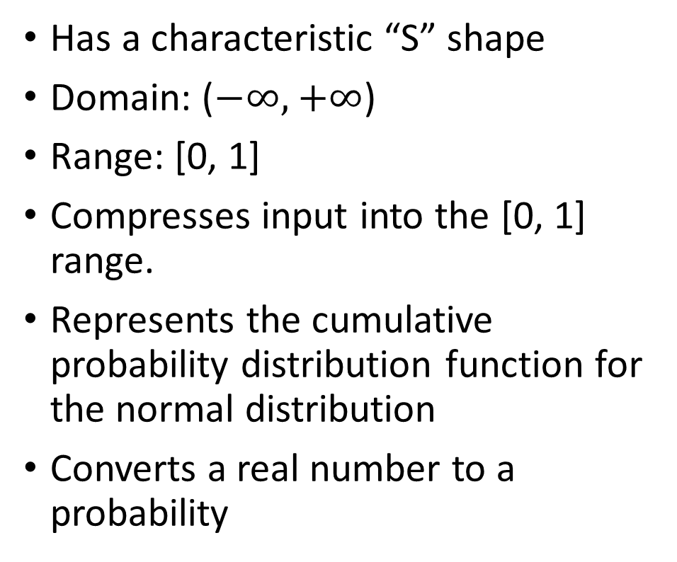
Sigmoid Function
Has a characteristic “S” shape
Domain: ($−∞,$ $+∞$)
Range: [0, 1]
Compresses input into the [0, 1] range.
Represents the cumulative probability distribution function for the normal distribution
Converts a real number to a probability

Slide 29
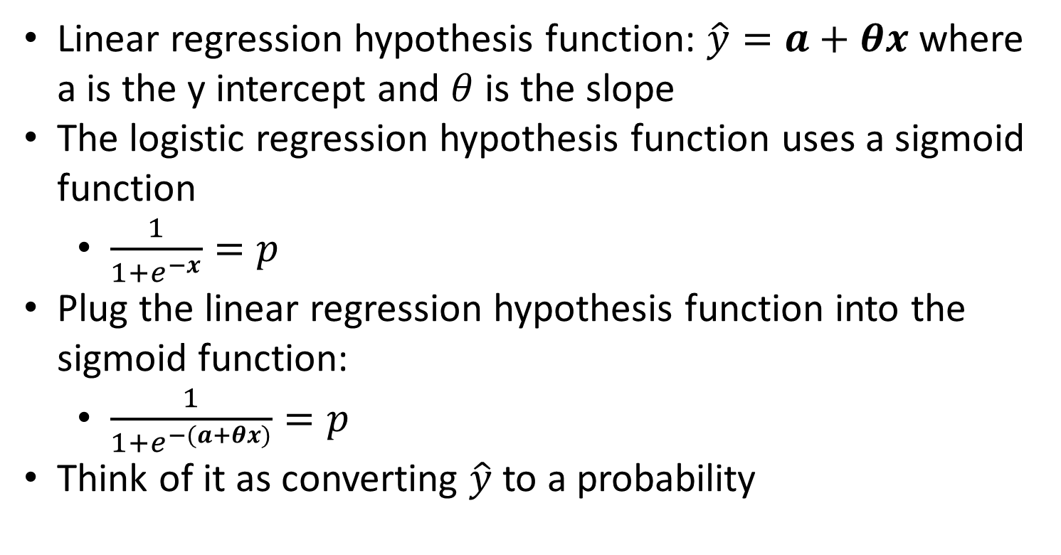
Relationship between linear and logistic Regression
Linear regression hypothesis function: $\hat{y}=a+θx$ where a is the y intercept and $θ$ is the slope
The logistic regression hypothesis function uses a sigmoid function
$\frac{1}{1+e^{−x}}=p$
Plug the linear regression hypothesis function into the sigmoid function:
$\frac{1}{1+e^{−(a+θx)}}=p$
Think of it as converting $\hat{y}$ to a probability

Slide 30
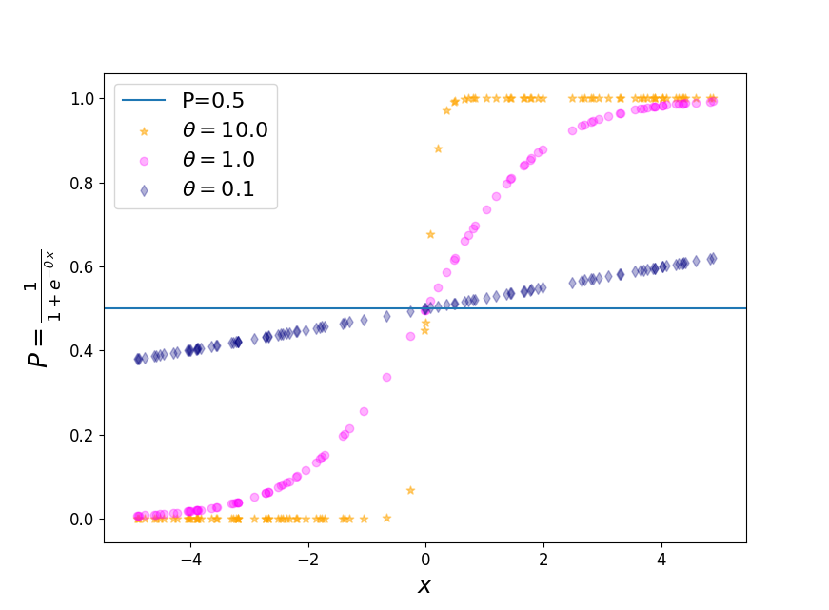

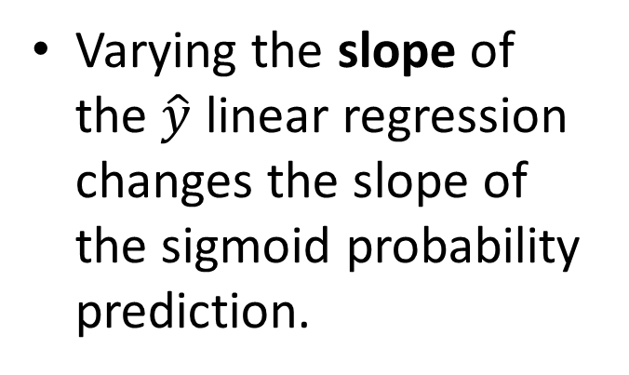
Sigmoid Shape as slope coefficient ($θ$) is varied
Varying the slope of the $\hat{y}$ linear regression changes the slope of the sigmoid probability prediction.
https://towardsdatascience.com/logit-of-logistic-regression-understanding-the-fundamentals-f384152a33d1

Slide 31
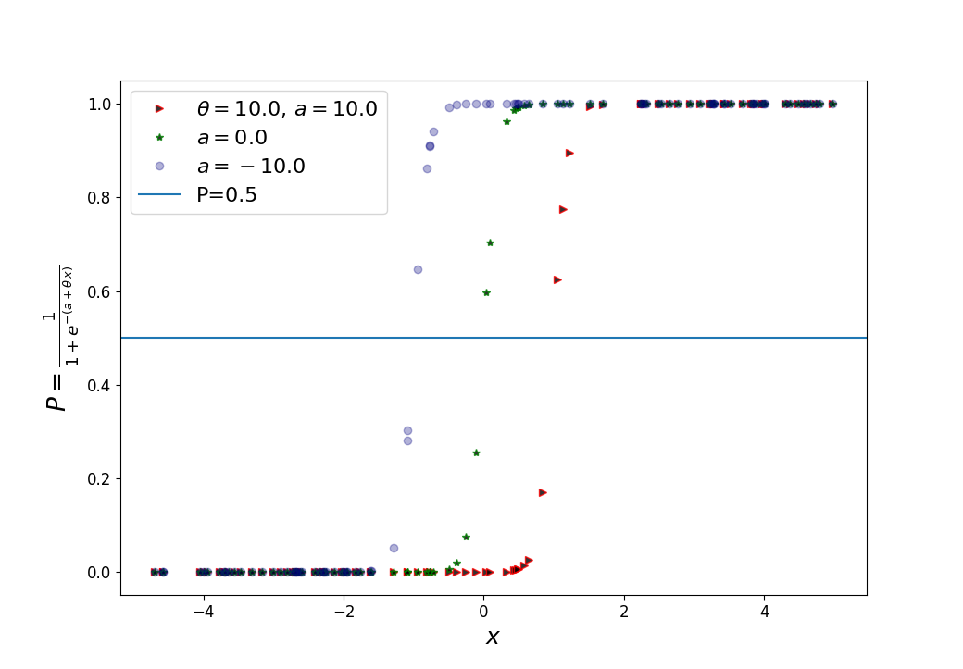
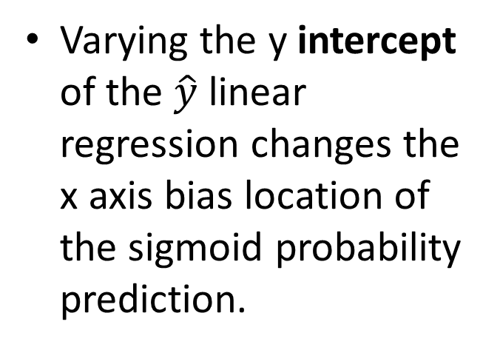
Sigmoid shape as intercept (a) is varied
Varying the y intercept of the $\hat{y}$ linear regression changes the x axis bias location of the sigmoid probability prediction.
https://towardsdatascience.com/logit-of-logistic-regression-understanding-the-fundamentals-f384152a33d1

Slide 32
Logistic regression hypothesis function: What are the odds
Odds are a measure of the likelihood of a particular outcome
Odds are a way of stating wins to losses or successes to failures
The ratio of the number of desired / winning outcomes to the number of undesired / losing outcomes
Example: Odds of rolling a 6-sided die and obtaining a 6 are 1:5
Notes:
https://machinelearningmastery.com/logistic-regression-with-maximum-likelihood-estimation/
https://en.wikipedia.org/wiki/Odds

Slide 33
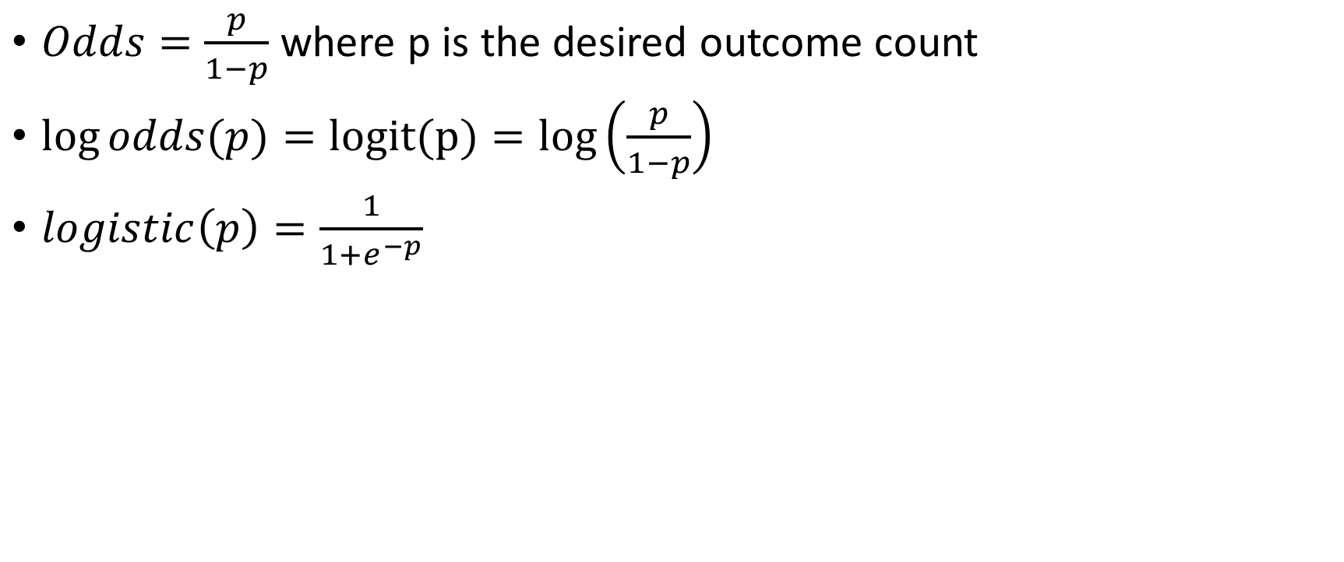
Log Odds (logit) Relation to Logistic Regression
$Odds=\frac{p}{1−p}$ where p is the desired outcome count
$\log{odds(p)=logit(p)=log⁡\left(\frac{p}{1−p}\right)}$
$logistic\left(p\right)=\frac{1}{1+e^{−p}}$

Slide 34
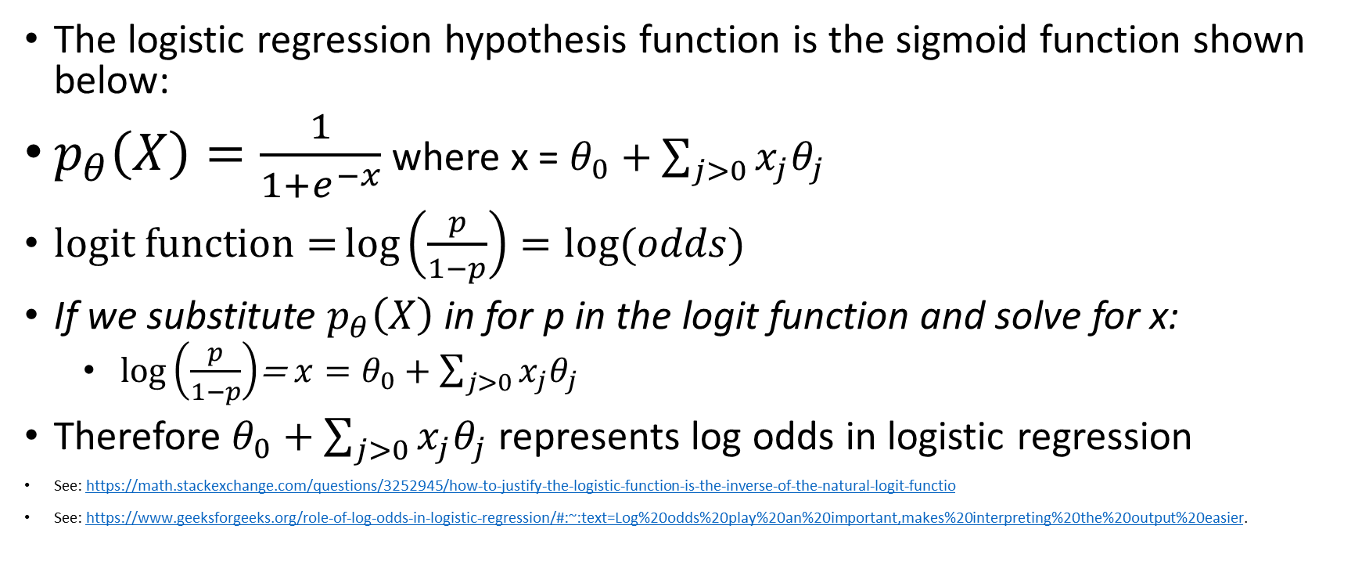
Log Odds (logit) Relation to Logistic Regression
The logistic regression hypothesis function is the sigmoid function shown below:
$p_{θ}\left(X\right)=\frac{1}{1+e^{−x}}$ where x = $θ_{0}+\sum_{j>0}{x_{j}θ_{j}}$
$logit function={log\left(\frac{p}{1−p}\right)}=log⁡(odds)$
If we substitute $p_{θ}\left(X\right)$ in for p in the logit function and solve for x:
$log\left(\frac{p}{1−p}\right)$= ${x=θ}_{0}+\sum_{j>0}{x_{j}θ_{j}}$
Therefore $θ_{0}+\sum_{j>0}{x_{j}θ_{j}}$ represents log odds in logistic regression
See: https://math.stackexchange.com/questions/3252945/how-to-justify-the-logistic-function-is-the-inverse-of-the-natural-logit-functio
See: https://www.geeksforgeeks.org/role-of-log-odds-in-logistic-regression/#:~:text=Log%20odds%20play%20an%20important,makes%20interpreting%20the%20output%20easier.
Notes:
https://machinelearningmastery.com/logistic-regression-with-maximum-likelihood-estimation/
https://sciphy-stats.com/post/interpreting-logistic-regression-coefficients-odds-ratios/

Slide 35
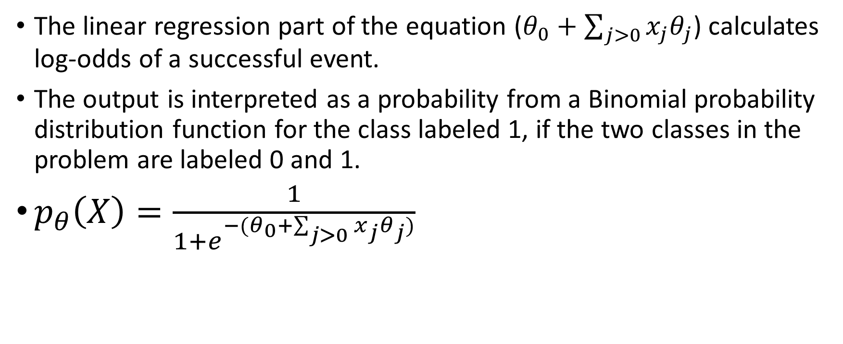
Logistic regression hypothesis function
The linear regression part of the equation ($θ_{0}+\sum_{j>0}{x_{j}θ_{j}}$) calculates log-odds of a successful event.
The output is interpreted as a probability from a Binomial probability distribution function for the class labeled 1, if the two classes in the problem are labeled 0 and 1.
$p_{θ}\left(X\right)=\frac{1}{1+e^{−(θ_{0}+\sum_{j>0}{x_{j}θ_{j})}}}$
Notes:
https://machinelearningmastery.com/logistic-regression-with-maximum-likelihood-estimation/

Slide 36
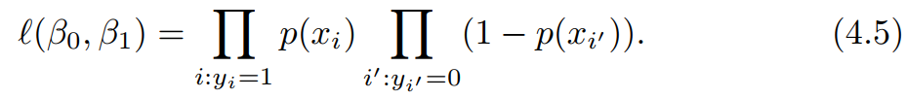
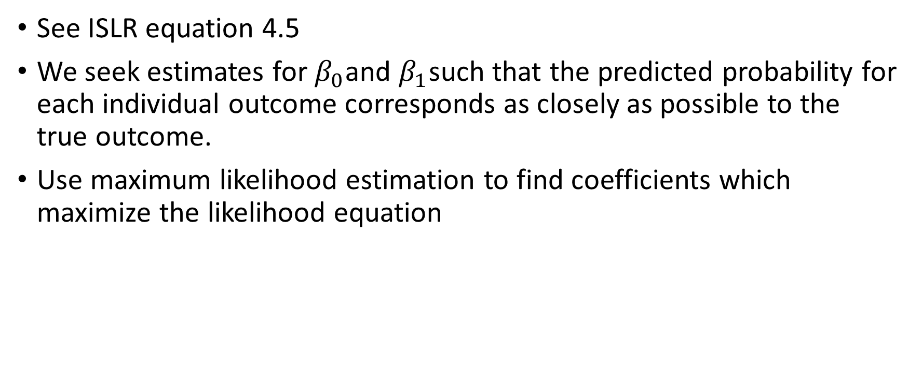
How do we estimate coefficients: Maximum Likelihood
See ISLR equation 4.5
We seek estimates for $β_{0}$and $β_{1}$such that the predicted probability for each individual outcome corresponds as closely as possible to the true outcome.
Use maximum likelihood estimation to find coefficients which maximize the likelihood equation
Notes:
See https://machinelearningmastery.com/logistic-regression-with-maximum-likelihood-estimation/

Slide 37
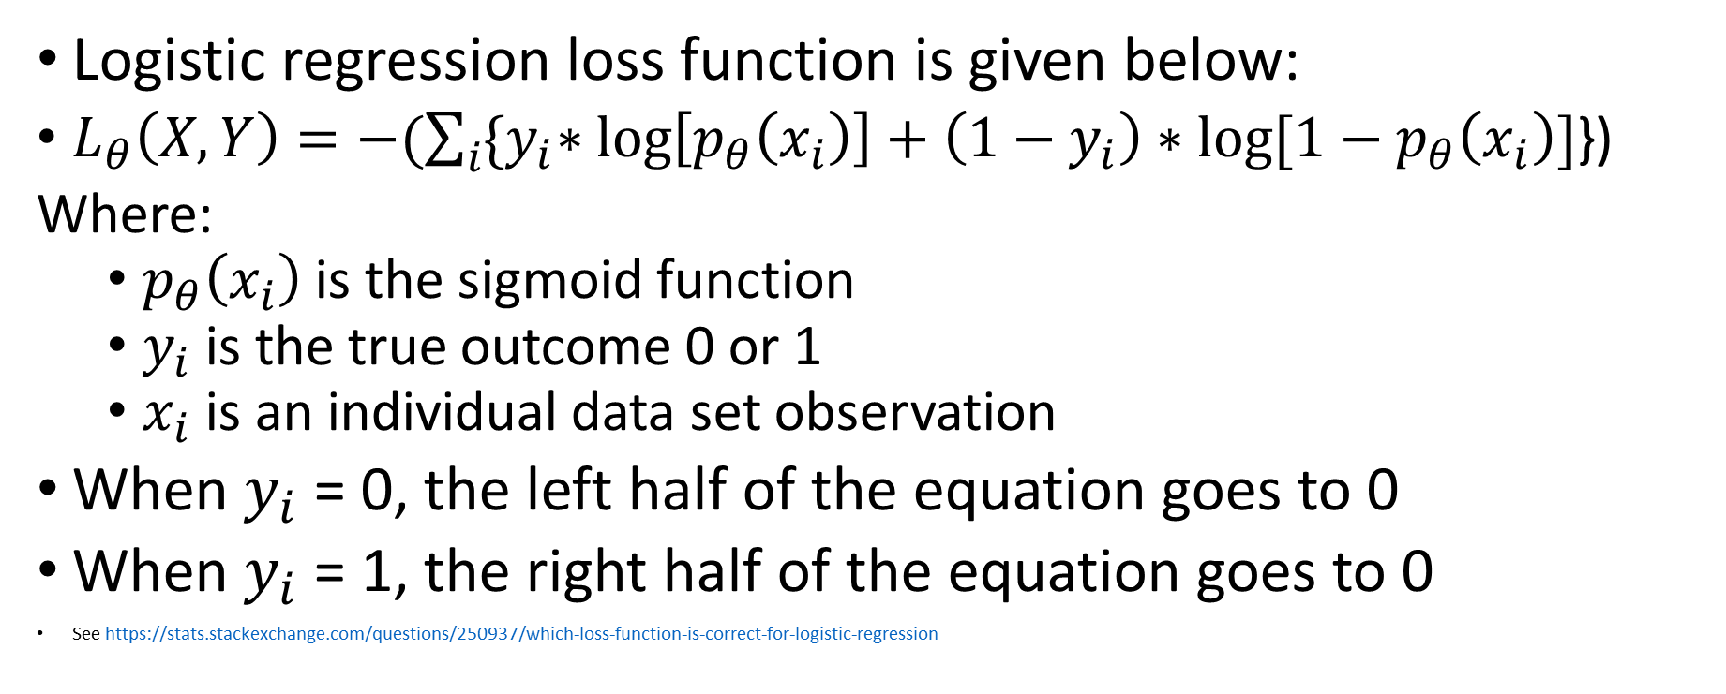
Logistic regression loss function
Logistic regression loss function is given below:
$L_{θ}\left(X,Y\right)=−(\sum_{i}{{\{y}_{i}∗\log\left[p_{θ}\left(x_{i}\right)\right]+\left(1−y_{i}\right)∗log⁡[1−p_{θ}\left(x_{i}\right)]}$})
Where:
$p_{θ}\left(x_{i}\right)$ is the sigmoid function
$y_{i}$ is the true outcome 0 or 1
$x_{i}$ is an individual data set observation
When $y_{i}$ = 0, the left half of the equation goes to 0
When $y_{i}$ = 1, the right half of the equation goes to 0
See https://stats.stackexchange.com/questions/250937/which-loss-function-is-correct-for-logistic-regression

Slide 38
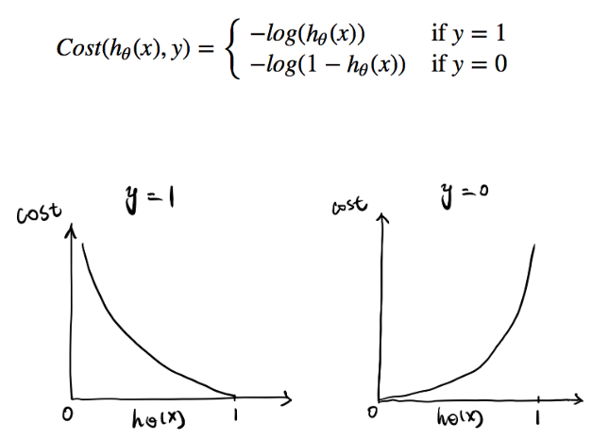
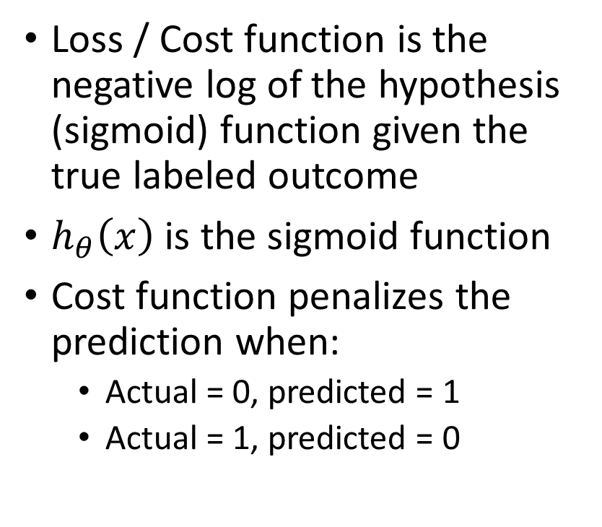
Logistic Regression Loss Function
Loss / Cost function is the negative log of the hypothesis (sigmoid) function given the true labeled outcome
$h_{θ}\left(x\right)$ is the sigmoid function
Cost function penalizes the prediction when:
Actual = 0, predicted = 1
Actual = 1, predicted = 0
Notes:
https://towardsdatascience.com/optimization-loss-function-under-the-hood-part-ii-d20a239cde11

Slide 39
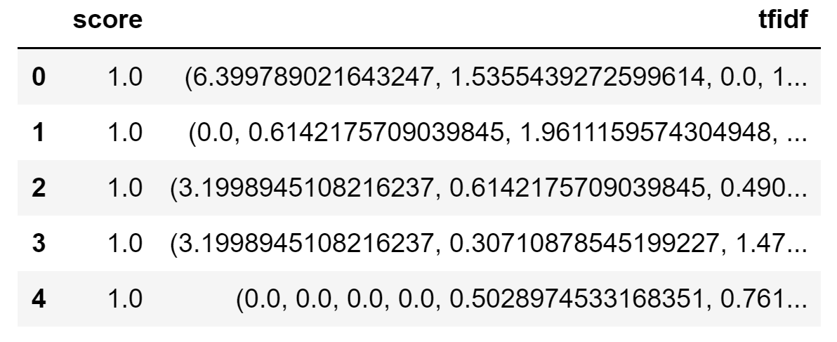
Sample Logistic Regression Training Data
X = tfidf
Y = score

Slide 40
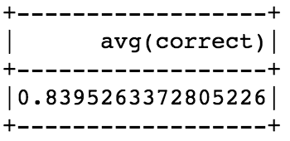
Logistic regression to estimate sentiments
Splits: Training (60%), validation (30%), and testing (10%)
Performance on validation set:
Much better than simple approach (73% accuracy)

Slide 41
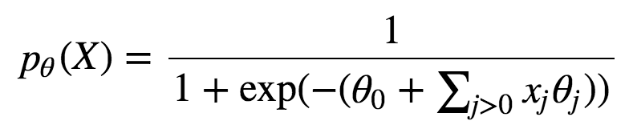
Examining the fit
Logistic regression estimated the weight of each word ($θ_{word}$) using the sigmoid function
Therefore, we can see which words are “negative” and which are “positive”!
$$\frac{1}{1+e^{−z}}$$
Sentiment
Probability
z
z

Slide 42
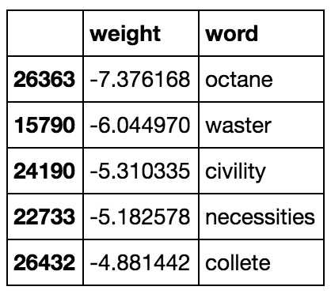
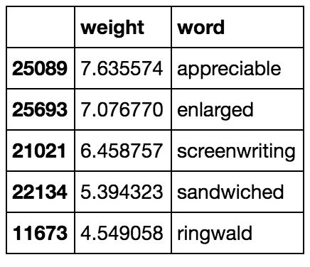
Examining the fit
Most negative words according to logistic regression
Most positive words:
Essentially, the logistic regression weights are encoding the sentiment

Slide 43
Something is off: overfitting
Notice that there are 29K+ words (cols) in the dataset but only 15K observations (rows) are used for training.
#features > #training examples leads to overfitting
We could try to select features by searching (See ISLR 6.1.2) but it would take too long for 29K features
Remember that the variance of a regression model is directly proportional to the number of features in the data set: As num features increases, model variance increases
What happens as model variance increases?

Slide 44
What is regularization from a high level
Regularization starts with the notion that large weights lead to overfitting.
Regularization is a mathematical tool to penalize large weights during the training process
Essentially, larger weights would normally lead to a lower loss when evaluating the loss function.
Regularization adds a fraction of the weights to the resulting loss thus larger weights yield a higher loss
Summary: The higher the weights, the higher the loss

Slide 45
Regularized logistic regression
We can instead create a loss function that penalizes weights.
This approach is called regularization.
There are two main regularization methods, L2 (or ridge) and L1 (or lasso)
L2 refers to the L2 Norm
L1 refers to the L1 Norm

Slide 46
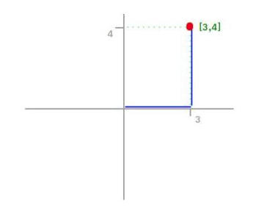
L1 Norm
L¹ Norm is sometimes called the taxicab or Manhattan norm because it represents the total distance traveled between the start and end of the vector.
One of the most common Norms
${∥x ∥}_{1}=$ |3| + |4| = 7

Slide 47
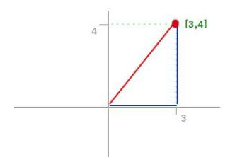
Review: L2 Norm
L² Norm calculates the shortest distance between the start
Also known as the “Euclidian” Norm
${∥x ∥}_{2}=\sqrt{3^{2}+4^{2}}=5$
5

Slide 48
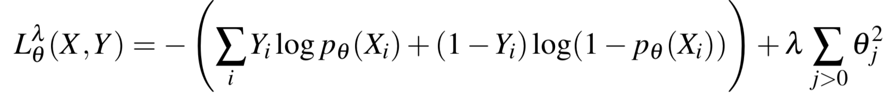
L2 regularization
We build an alternative loss function where the weights of the parameters quadratically increase the loss
Think twice about increasing the importance of a word in the prediction if the weight associated with that word is large
Includes ALL predictors in the output: Weights do not shrink to 0
How well we fit the data
Sum of weights squared

Slide 49
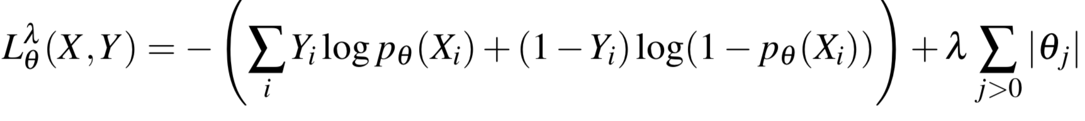
L1 regularization
One problem with L2 regularization is that weights don’t shrink to 0.
This is undesirable because intuitively some features do not matter
L1 can shrink weights to 0 thus performing feature selection
We penalize learning by the absolute value of the weight.
How well we fit the data
Sum of weights

Slide 50
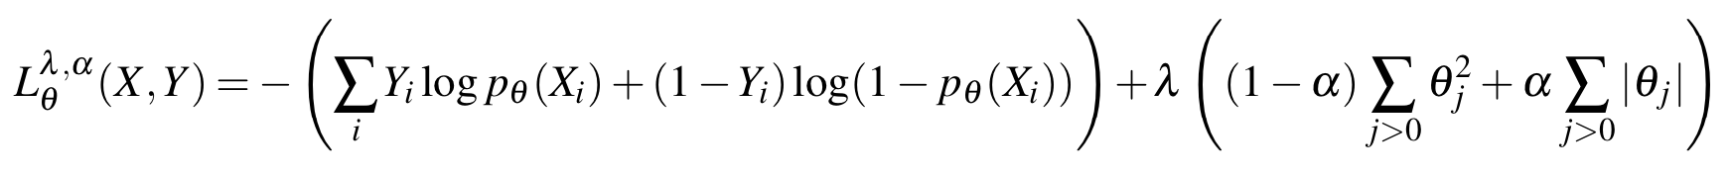
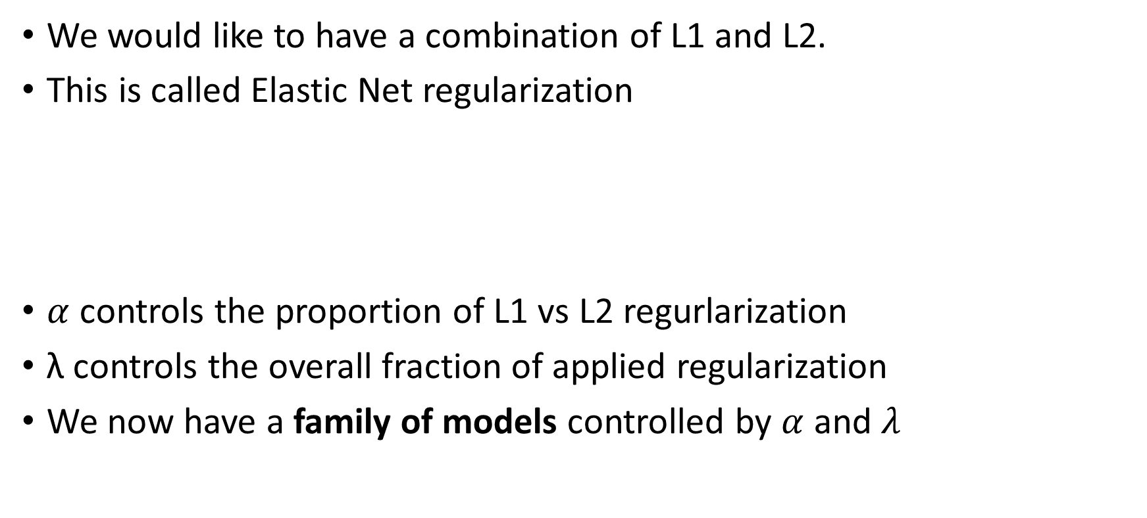
Elastic net regularization
We would like to have a combination of L1 and L2.
This is called Elastic Net regularization
$α$ controls the proportion of L1 vs L2 regurlarization
λ controls the overall fraction of applied regularization
We now have a family of models controlled by $α$ and $λ$

Slide 51
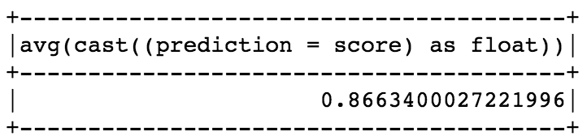
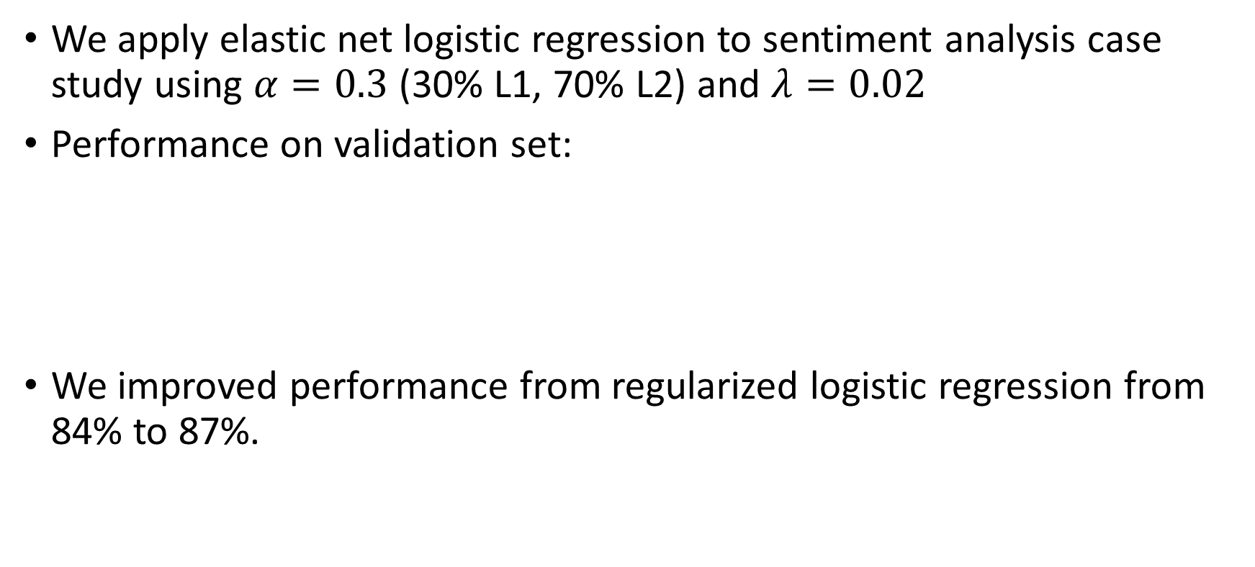
Elastic net logistic regression
We apply elastic net logistic regression to sentiment analysis case study using $α=0.3$ (30% L1, 70% L2) and $λ=0.02$
Performance on validation set:
We improved performance from regularized logistic regression from 84% to 87%.

Slide 52
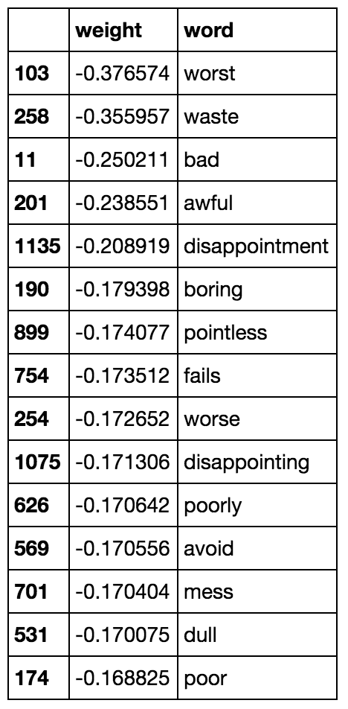
Word-level sentiments
The most negative words:
“worst” is more negative than “worse”
(makes sense)

Slide 53
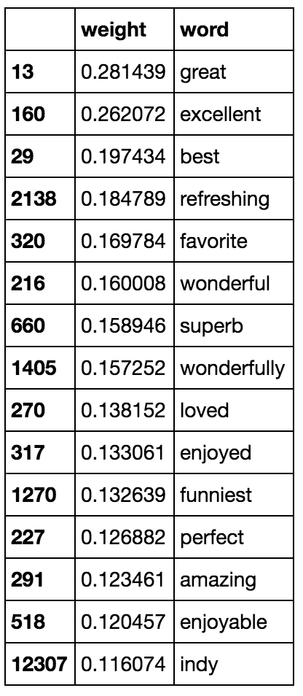
Word-level sentiments
The most positive words:

Slide 54
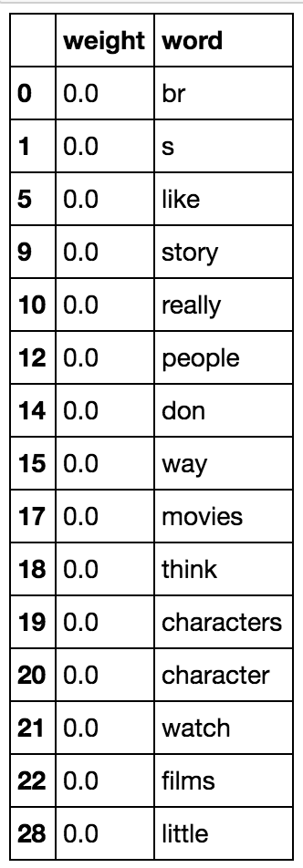
Automatic feature selection with L1
This model has 25554 features with exactly zero weight! (95% of features)

Slide 55
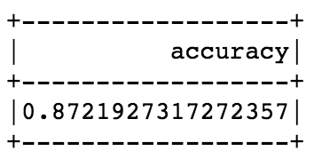
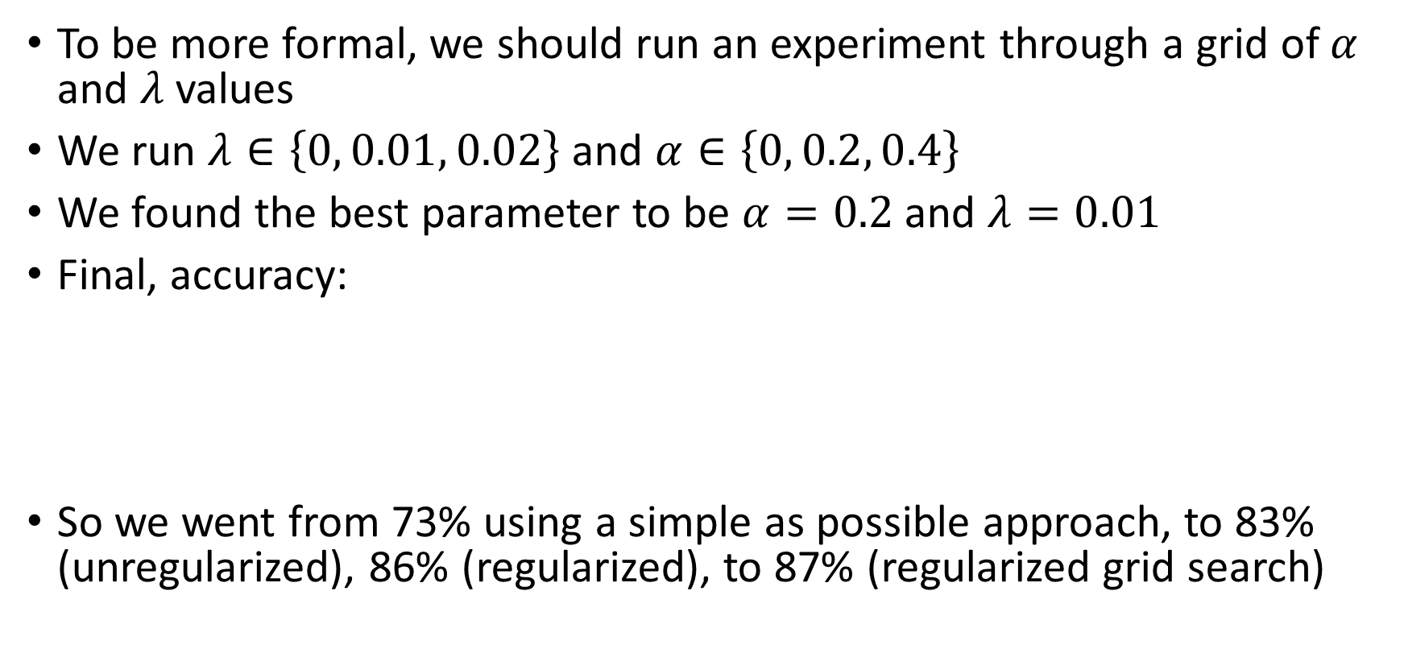

Grid Search: How we choose $α$ and $λ$?
To be more formal, we should run an experiment through a grid of $α$ and $λ$ values
We run $λ∈\left\{0, 0.01, 0.02\right\}$ and $α∈\left\{0, 0.2, 0.4\right\}$
We found the best parameter to be $α=0.2$ and $λ=0.01$
Final, accuracy:
So we went from 73% using a simple as possible approach, to 83% (unregularized), 86% (regularized), to 87% (regularized grid search)

Slide 56
How should we report the final performance of our case study?
We used the training dataset to fit each model in the grid search
We used the validation dataset to compare across models in the grid search and select the best model
We report the performance of the best model (chosen using validation data) using the test dataset.

Slide 57
Examining problems with the model
Logistic regression computes the probability that an example belongs to a class
With this, we can examine the places where our model is most wrong in the supervised data
Also, we can examine where our model is most confident about a prediction
Examining the most wrong and most confident outcomes may lead to insights that can be used to improve the model

Slide 58
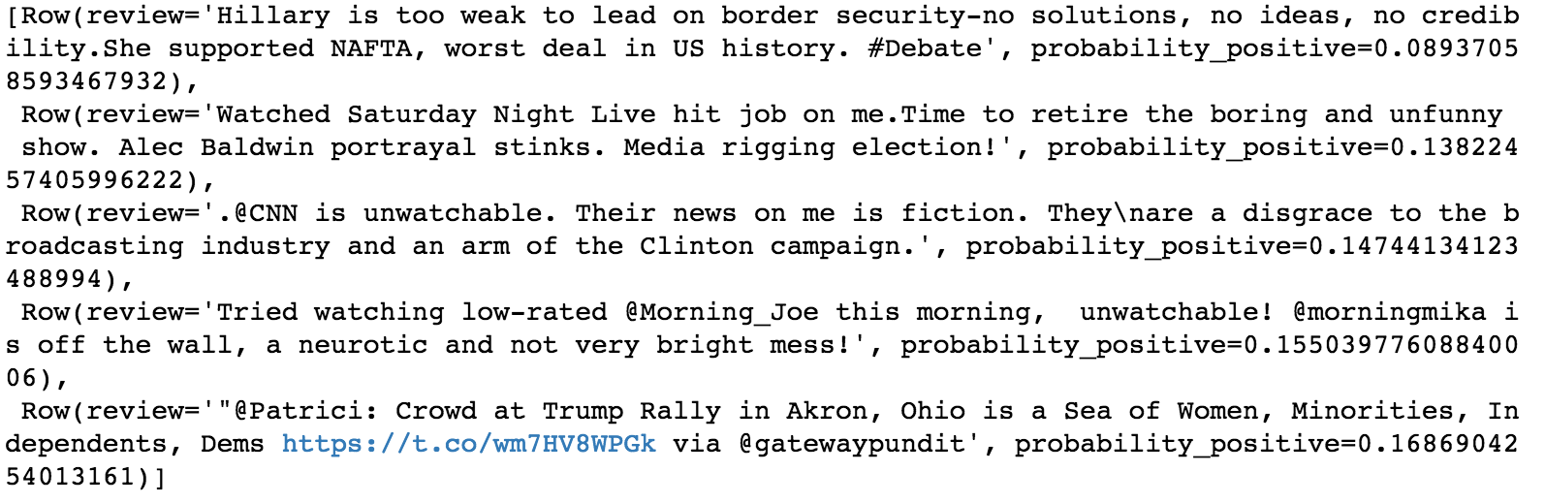
Applying it to Twitter data
Applying our model to a sample of 1K tweets from each 2016 US presidential candidate.
Sample of Trump’s tweets that are negative (with high confidence):

Slide 59

Applying it to Twitter data
A sample of Clinton’s tweets that are negative (with high confidence)

Slide 60

Applying it to Twitter data
Positive Trump tweets:

Slide 61

Applying it to Twitter data
Positive Clinton tweets:

Slide 62
Applying it to Twitter data
And the verdict is:
Clinton is significantly more negative than Trump!
Any ideas why?

Slide 63
Attendance
Please fill out the attendance sheet: https://docs.google.com/spreadsheets/d/1G5tiqXQn9mwyubWdINtPI_QONXH1_2U8oYikksgWlss/edit?usp=sharing
Write in a ‘1’ if you are present

